Slide 1
微机原理与接口技术
Theory and Interface Technology of Microcomputer
北京化工大学
信息科学与技术学院
主讲教师： 郭青
guoqing@mail.buct.edu.cn

Slide 2
课程内容
Intel系列微处理器
计算机的硬件结构，工作原理，
指令系统，汇编语言程序设计，
计算机接口技术
参考教材：
扬素行等。微型计算机系统原理及应用（第3版），清华大学出版社，2009年4月
(美）Barry B. Brey (DeVry 大学）著。Intel微处理器（英文版，第7版），机械工业出版社

Slide 3

课程要求
●共72学时，其中上机8学时，实验8学时，
教学56学时
●作业、考勤、上机、实验：20分
●大作业10分
● 笔试考试：70分
考试周考试

Slide 4
CHAPTER 1
Basis of Microcomputer

Slide 5
1.1 Introduction
1.1.1 Historical Background
The Mechanical Age
Abacus ― Babylonian 500 B. C.
Analytical Engine ― Charles Babbage, G.B., 1823
The electrical Age
Z3 computer ― Konrad Zuse, Germany, 1941
Colossus ― Alan Turing, G.B., 1943
Special-purpose computer
ENIAC ― University of Pennsylvania, USA, 1946
General-purpose, programmable computer
The Microprocessor Age
Intel 4004 ― 4-bit microprocessor, IBM, 1971
Notes:
分析机算得上是世界上第一台计算机。十九世纪三十年代，英国数学家、发明家查尔斯.巴贝尔设计了分析机。(was designed, but never built) 分析机采用的一些计算机思想延用至今。分析机包括的存储和碾磨，就非常类似于今天计算机中采用的内存和处理器。输入和输出都采用打孔卡（十九世纪Jacquard发明的一种卡片）进行。 巴贝尔1834年开始进行分析机的研究工作。他把分析机制造成了由黄铜配件组成，用蒸汽驱动的机器。当时，分析机的出现并没有带来石破天惊的震撼，也没有被广泛的接受。一直要到1890年，同样利用打洞卡为基础，美国统计学家赫曼?霍勒瑞斯（Herman Hollerith）因应美国人口普查局的需要所发明的电动制表机（Electric Tabulating Machine），才开始应用在实务的信息处理上。巴贝尔的工作得到了Ada Augusta??拉弗拉斯伯爵夫人的大力支持，Ada被广泛认为是世界上第一个程序员。她设计了一个打孔卡片程序用来计算贝努力数列。
本篇文章来源于 中国协议分析网|www.cnpaf.net 原文链接：http://www.cnpaf.net/Class/a/200510/5278.html
1941年，第三台电磁式计算机Z－3完成，使用了2600个继电器，用穿孔纸带输入，实现了二进制数程序控制。程序控制思想虽然过去也有人提倡，但楚泽是把它付诸实施的第一人。Z－3能达到每秒3～4次加法的运算速度，或者在3～5秒内完成一次乘法运算。1942年，在紧张研究的间隙里，他写作了世界上第一个下国际象棋的计算机程序。
Colossus - Alan Turing阿兰.图灵, USA, 1943 电子管计算机，为破译二战期间德国密码机“谜”而研制。
ENIAC 电子数值积分计算器, 1946年在美国宾夕法尼亚大学

Slide 6
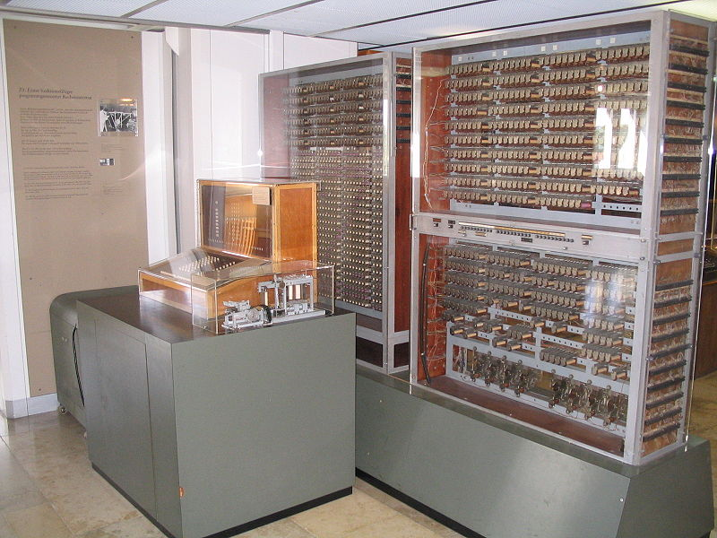
Z3 Computer

Slide 7

1.1.2 Application
信息处理
事务处理、管理应用
人工智能
感知、推理、学习、理解
机器人
实时控制
过程控制、模拟
辅助设计CAD
CAT、CAM、CAI、CAE
Internet 网络
远程教育、医疗

Slide 8
1.1.3 The Microprocessor-Based Personal Computer System
Buses
Memory
System
Microprocessor
I/O
System
RAM
ROM
Cache
Flash memory
EEPROM
SDRAM
8086
8088
80x86
Pentium
Pentium X
Printer
Disk drive
Mouse
Keyboard
Monitor
Serial communication
Hardware

Slide 9
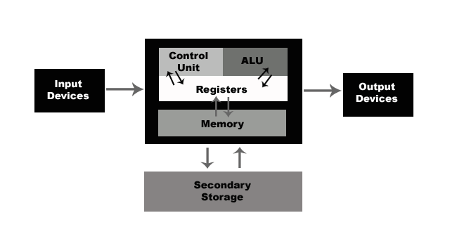
Block Diagram of a Computer system
Central Processing Unit
(CPU)
General purpose register
Special function register

Slide 10
Important Concepts
1. Five components partitioning (evolving into three major parts)
Input
Output
Memory
Calculator
Control unit
2.Bus
A collection of electronic signals all dedicated to particular task is called a bus
–Address bus
–Data bus
–Control bus
I/O devices
Memory
CPU

Slide 11
Data Bus
The width of the data bus determines how much data the processor can read or write in one memory or I/O cycle
数据总线的位数决定了处理器与存储器或处理器与I/O设备在一个读写周期中传送数据的位数
8-bits microprocessor has an 8-bit data bus
8086 16-bits data bus
80386 32-bits internal and external data buses
Pentium X 64-bits data bus

Slide 12
Address Bus
The address bus is used to identify the memory location or I/O device (also called port) the processor intends to communicate with 给出存储器或者I/O的位置
  20 bits for the 8086 and 8088
  32 bits for the 80386/80486 and the Pentium
  36 bits for the Pentium II, III and 4
The total number of memory locations addressable by a given CPU is always equal to 2^x where x is the number of address bits, regardless of the data bus.
8086 has a 20-bit address bus and therefore addresses all combinations of addresses from all 0s to all 1s. This corresponds to 2^20 addresses or 1M (1 Meg) addresses or memory locations.
Pentium: 4Gbytes main memory.

Slide 13
Control BUS
How can we tell the address is a memory address or an I/O port address
–Memory Read
–Memory Write
–I/O Read
–I/O Write
When Memory Read or I/O Read are active, data is input to the processor.
When Memory Write or I/O Write are active, data is output from the processor.
The control bus signals are defined from the processor’s point of view.
Control and address lines are output lines only, but the data bus is bidirectional

Slide 14
Software
System Software
helps use the operating system and computer system
Application Software

Slide 15
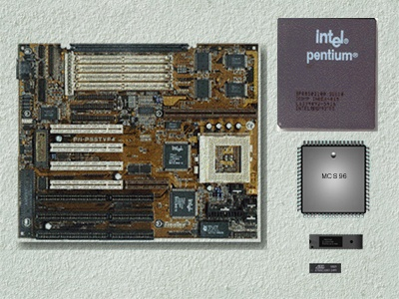
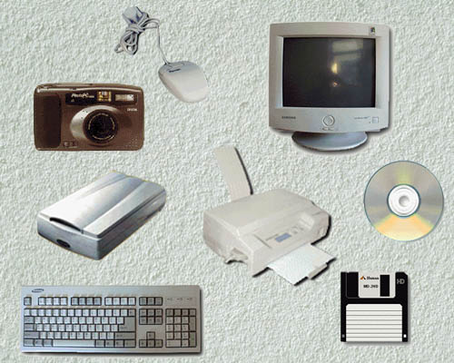

Slide 16
Some Important Terminology
• Bit is a binary digit that can have the value 0 or 1
•A byte is defined as 8 bits
•A word is two bytes
•A double word is four bytes
•A kilobyte is 2^10 bytes (1024 bytes), The abbreviation K is most often used–Example: A floppy disk holding 356Kbytes of data
•A megabyte or meg is 2^20 bytes, it is exactly 1,048,576 bytes
•A gigabyte is 2^30 bytes

Slide 17
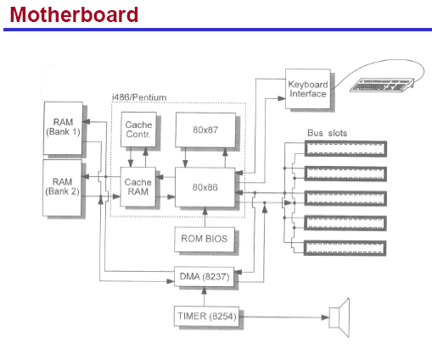

Slide 18
1.1.4 Computer Performance
字长： Data Bus Width
内存容量：Memory Size
运算速度：
时钟频率： Clocking Frequency

Slide 19
1.2 Data in Computer

Slide 20
1.2.1 Number System
Binary 二进制
Decimal 十进制
Hexadecimal 十六进制
Conversions between different number base
Digits: 0,1 for Binary
0,1,2,…,9 for Decimal
0,1,2,….,A,B,C,D,E,F for Hexadecimal

Slide 21
Positional notation
Each digit position with its power and weight or value
Example
Power 幂 2² 2¹ 2⁰ 2⁻¹ 2⁻² 2⁻³
Weight 权 4 2 1 0.5 0.25 0.125
Number 1 1 0 . 1 0 1
Numeric Value 4 + 2 + 0 + 0.5 + 0 + 0.125 = 6.625

Slide 22
Conversion to Decimal
Determine the weights or values of each position of the number
Sum the weights to form the decimal equivalent
Example
Power 16¹ 16⁰ 16⁻¹
Weight 16 1 0.0625
Number 6 A . C
Numeric Value 96 + 10 + 0.75 = 106.75

Slide 23
Conversion from Decimal
Whole number portion: divide by the radix 基数
Fractional portion: multiply by the radix
Whole number portion 整数部分
1. Divide the decimal number by the radix (number base)
2. Save the remainder (first remainder is the least significant digit) 有效数字
3. Repeat steps 1 and 2 until the quotient is zero
Notes:
Quotient 商 significant digit 有效数字

Slide 24
Conversion from Decimal
Example 1
Decimal 109 → Hexadecimal ?
= 6D H
16) 109
16) 6 remainder = 13 (D)
0 remainder = 6
Least bit
Most bit
Example 2
Decimal 10 → Binary ?
= 1010 B
2) 10
2) 5 remainder = 0
2) 2 remainder = 1
2) 1 remainder = 0
0 remainder = 1
LSB
MSB

Slide 25
Conversion from Decimal Fraction
十进制小数转换成其它进制
1. Multiply the decimal fraction by the radix
2. Save the whole number portion of the result as a digit. (first result is to the right of the radix point).
3. Repeat steps 1 and 2, using the fraction part of step 2 until the fraction part of step 2 is zero.

Slide 26
Example
Decimal 0.125 → Binary ?
0.001 B
.125
X 2
0.25 digit is 0
left
.25
X 2
0.5 digit is 0
.5
X 2
1.0 digit is 1
right
Fraction part is 0

Slide 27
Convert Binary number into Decimal
1DAC.A8H
Example：1110110101100.10101B = ?H
4位一组，不足4位补0
1110110101100.10101
0001110110101100.10101000
↓ ↓ ↓ ↓ ↓ ↓
1 D A C . A 8
1110110101100.10101B = 1DAC.A8H

Slide 28
Convert Hexadecimal number into Binary
Example: 39F.E1AH = ? B
11 1001 1111.1110 0001 101B
3 9 F . E 1 A
↓ ↓ ↓ ↓ ↓ ↓
001110011111 . 111000011010
39F.E1AH = 0011 1001 1111.1110 0001 1010B

Slide 29
表2-1 十进制、二进制、八进制、十六进制数码对照表
十进制
二进制
八进制
十六进
十进制
二进制
八进制
十六进
制
制
0
0000B
0Q
0H
9
1001B
11Q
9H
1
0001B
1Q
1H
10
1010B
12Q
AH
2
0010B
2
Q
2H
11
1011B
13Q
BH
3
0011B
3Q
3H
12
1100B
14Q
CH
4
0100B
4Q
4H
13
1101B
15Q
DH
5
0101B
5Q
5H
14
1110B
16Q
EH
6
0110B
6Q
6H
15
1111B
17Q
FH
7
0111B
7Q
7H
16
10000B
20Q
10H
8
1000B
10Q
8H

Slide 30
1.2.2 Computer Data Format
ASCII
(American Standard Code for Information Interchange)
Represent alphanumeric characters
Standard ASCII code: 7-bit
the eighth and most significant bit: parity bit 奇偶位
Extended ASCII code: 8-bit vary for different machine

Slide 31
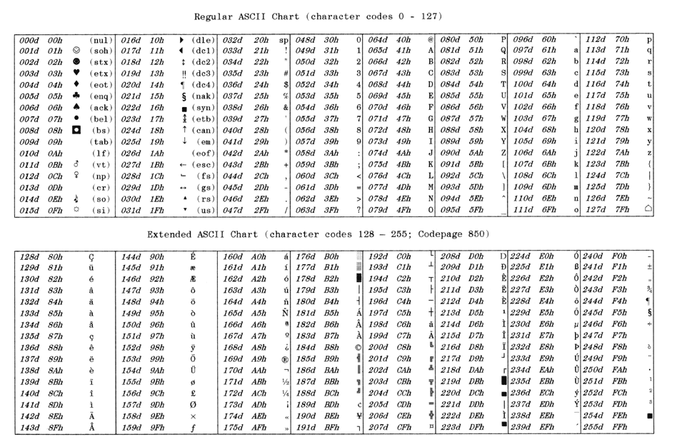
ASCII Code

Slide 32
BCD Data
Binary-Coded Decimal Data
8421 BCD data: 0000 ～ 1010 BCD
Decimal data: 0 ～ 10

Slide 33

Byte-Sized Data
Stored as unsigned and signed integers
Unsigned byte: 00H — FFH, 0 — 255
Signed byte: -128 to 0 to 127
80H 0 7FH
2补码
two’s
complement
0 to 7FH (+127) are positive numbers
80h (-128) to FFH (-1) are negative numbers

Slide 34
How to form a two’s complement
First one’s complement the number;
Form one’s complement, invert each bit 反码
Then add a one to the one’s complement.
Example
Decimal: - 36 十进制
Binary: - 0010 0110 B 二进制
One’s complement: 1101 1001 B 反码，1补码
Two’s complement: 1101 1010 B 补码

Slide 35
How to form two’s complement (2)
Start writing down the number from right to left.
Write the number exactly as it appears until the first one.
Write down the first one, and then invert of complement all remaining ones to its left.
Example
Decimal: - 36
Binary: - 0010 0110 B
Two’s complement: 1101 1010 B

Slide 36
Word-sized Data
Two bytes of memory, 16-bits
Doubleword-sized Data
Four bytes of memory, 32-bits

Slide 37
Real Numbers
Floating-point number 浮点数
31
30
23
22
0
S | Exponent 阶码 | Significant 尾码
·
Single-precision real number
63
62
52
51
0
S | Exponent | Significant
·
Double-precision real number

Slide 38
Summary
Three number bases: Binary, Decimal and Hexadecimal
Conversions between different number base
One’s complement and two’s complement
ASCII and BCD code
Floating-point number

